Slide 1


EAST WEST INSTITUTE OF TECHNOLOGY
DEPT OF INFORMATION SCIENCE AND ENGINEERING
Technical seminar on
“Portable Camera-Based Assistive Text and Product Label Reading From Hand-Held Objects for Blind Persons”
Presented By :
Sameeksha B.S
1EW16IS089
Dept. of ISE, EWIT
Under The Guidance :
Mrs. Bhavya T
Assistant Professor
Dept. of ISE, EWIT

Slide 2
CONTENT
Abstract
Introduction
Literature survey
Existing system
Proposed system
Design
Methodology
Object region detection
Text recognition and audio output
Applications
Conclusions
Thank you

Slide 3
Abstract
The system proposes a camera-based assistive text reading framework to help blind persons read text labels and product packaging from hand-held objects in their daily lives. To isolate the object from cluttered backgrounds or other surrounding objects in the camera view, system first propose an efficient and effective motion- based method to define a region of interest (ROI) in the video by asking the user to shake the object. Text localization and recognition are conducted to acquire text information. The recognition text codes are output to blind users in speech. Performance of the proposed text localization algorithm is quantitatively evaluated on ICDAR-2003 and ICDAR-2011 Robust Reading Datasets.

Slide 4
introduction
Development in computer vision, digital cameras, and portable computers make it feasible to assist these individual.
By developing cameras-based products which combine computer vision technology with other existing commercial products such optical character recognition (OCR) systems.
Already few portable systems exist like portable bar code reader, pen scanner, k mobile reader.

Slide 5
Literature survey
Sl.no | AUTHOR | TITLE | DESCRIPTION | YEAR OF PUBILICATION
1. | X. Yang, Y. Tian ,C . Yi and A. Arditi | Context-based indoor object detection as an aid to blind persons accessing unfamiliar environments. | In this paper , a computer vision –based indoor way finding system for assisting blind people to independently access unfamiliar buildings. | 2014
2. | D.Dakopoulos and N.G.Bourbakis | Wearable obstacle avoidance electronic travel aids for blind persons. | This paper presents a comparative survey among portable obstacle detection systems of an effort to inform the progress in assistive technology for blind persons. | 2014

Slide 6
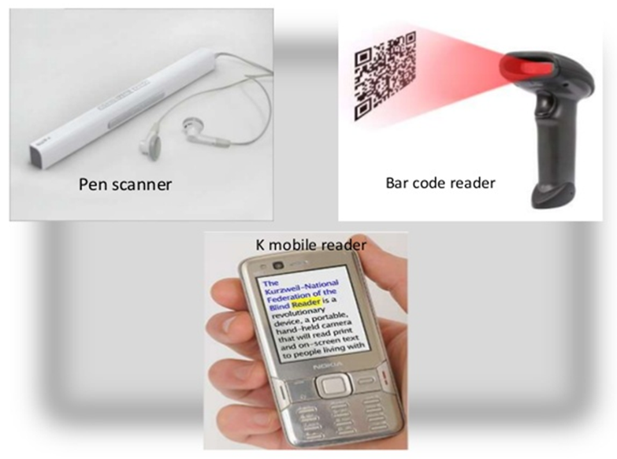
EXISTING SYSTEM
Walking safely and confidently without any human assistance in urban or unknown environments is a difficult task for blind people.
Visually impaired people generally use either the typical white cane or the guide dog to travel independently.
But these methods are used only to guide blind people for safe path movement, and these cannot provide any product assistance like shopping etc.,
Already few portable systems exist like portable bar code reader, pen scanner, k mobile reader for blind persons.

Slide 7
PROPOSED SYSTEM
The system proposes a camera-based label reader to help blind persons to read names of labels on the products.
Camera acts as main vision in detecting the label image of the product or board then image is processed internally.
And separates label from image , and finally identifies the product and identified product name is pronounced through voice.

Slide 8
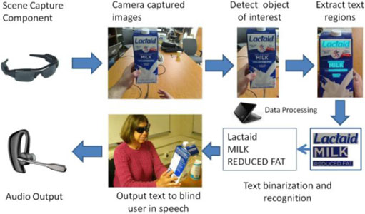

design

Slide 9
CONT..
Our main contributions embodied in this prototype system are…..
A novel motion-based algorithm to solve the aiming problem for blind users by their simply shaking the object of interest for a short period.
A novel algorithm of automatic text localization to extract text regions from complex background and multiple text patterns;
A portable camera-based assistive framework to aid blind persons reading text from hand-held objects.

Slide 10
METHODOLOGY
The system framework consists of three functional components:
Scene capture
Data processing
Audio output
The scene capture component collects scenes containing objects of interest in the form of images or video.
In the prototype system, it corresponds to a camera attached to a pair of sunglasses.
The data processing component is used for deploying the proposed algorithms, including

Slide 11
CONT..
Object-of-interest detection to selectively extract the image of the object held by the blind user from the cluttered background or other neutral objects in the camera view
Text localization to obtain image regions containing text, and
Text recognition to transform image-based text information into readable codes
The audio output component is to inform the blind user of recognized text codes.
A Bluetooth earpiece with mini microphone is employed for speech output.

Slide 12
OBJECT REGION DETECTION
To ensure that the hand-held object appears in the camera view, we employ a camera with a reasonably wide angle in the prototype system.
To extract the hand-held object of interest from other objects in the camera view.
we ask users to shake the hand-held objects containing the text they wish to identify.
then employ a motion-based method to localize the objects from cluttered background.
Background subtraction (BGS) is a conventional and effective approach to detect moving objects for video surveillance systems with stationary cameras.

Slide 13
Text recognition and audio output
Text recognition is performed by off-the-shelf OCR prior to output of informative words from the localized text regions.
A text region labels the minimum rectangular area for the accommodation of characters inside it.
OCR generates better performance if text regions are first assigned proper to the margin areas and binarized to segment text characters from background.
Thus, each localized text region is enlarged by enhancing the height and width by pixels respectively.

Slide 14
ADVANTAGES
It has many advantages to help blind persons to read content from the hand-held articles and it removes physical hardware requirement.
This is more efficient to produce currency notes using templates and it is automatic detection.
Portability.
Accuracy and Flexibility.
Portable camera based assistive text and product label reading from hand-held objects for blind persons method is an efficient and effective motion-based method to define a region of interest on image processing.

Slide 15
CONCLUSIONS
To read printed text on hand-held objects for assisting blind person in order to solve the common aiming problem for blind users. This method can effectively distinguish the object of interest from background or other objects in the camera view. To extract text regions from complex backgrounds, we have proposed a novel text localization algorithm based on models of stroke orientation and edge distributions. OCR is used to perform word recognition on the localized text regions and transform into audio output for blind users.

Slide 16


